Slide 1
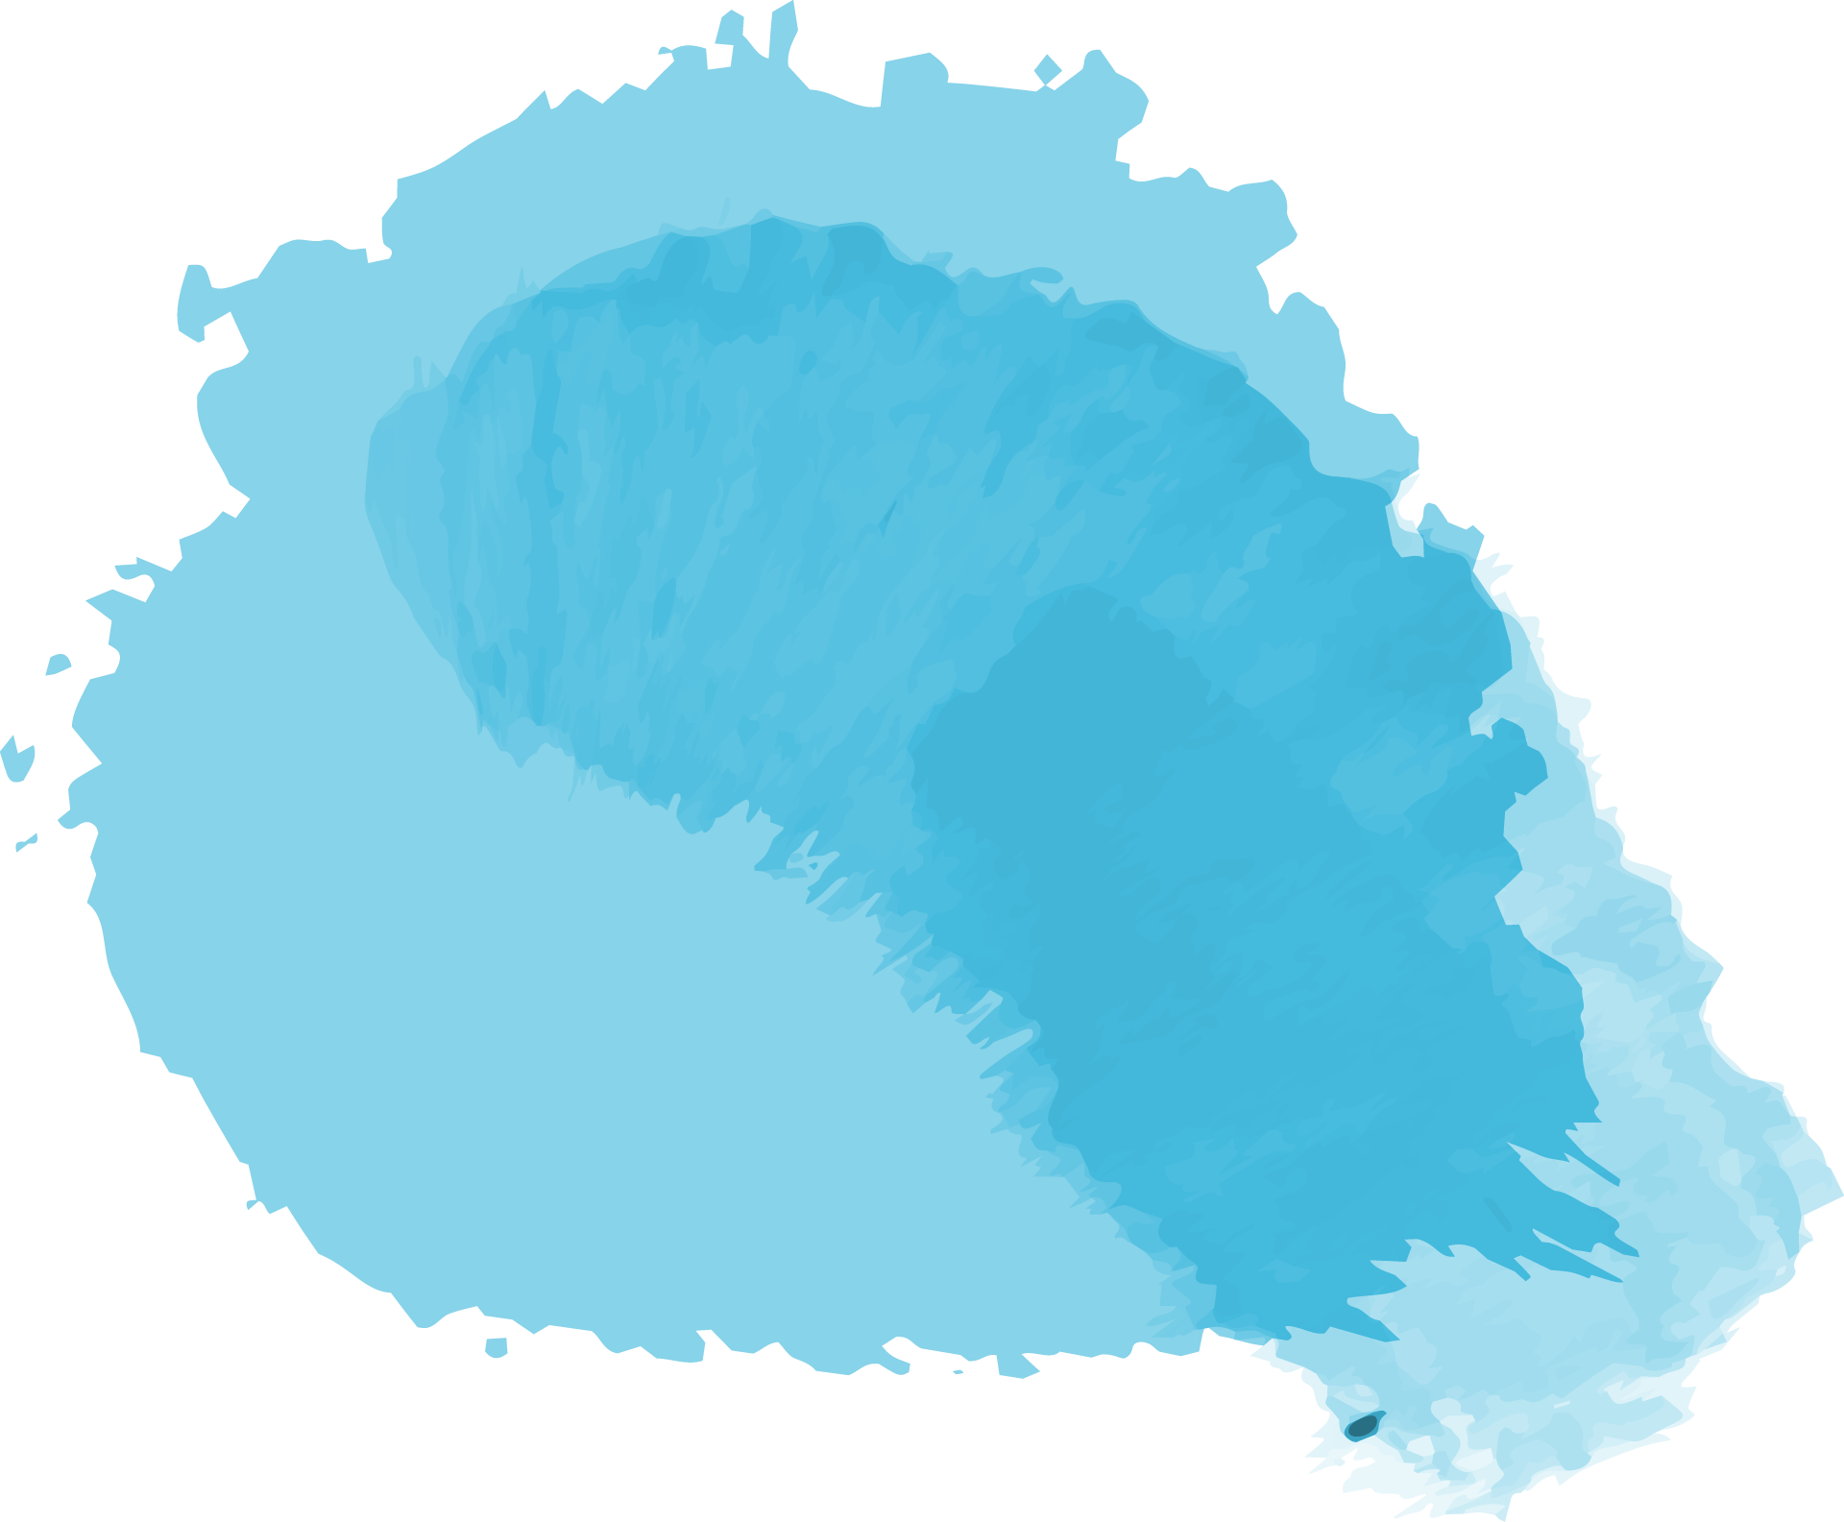


QH2O
WATER QUALITY SERVICES
Group 01

Slide 2


Team Members
S14025
S13990
S14028
*
*
*
B. Thanushan
W. S. S. Fernando
W. M. C. B. Weerakoon

Slide 3
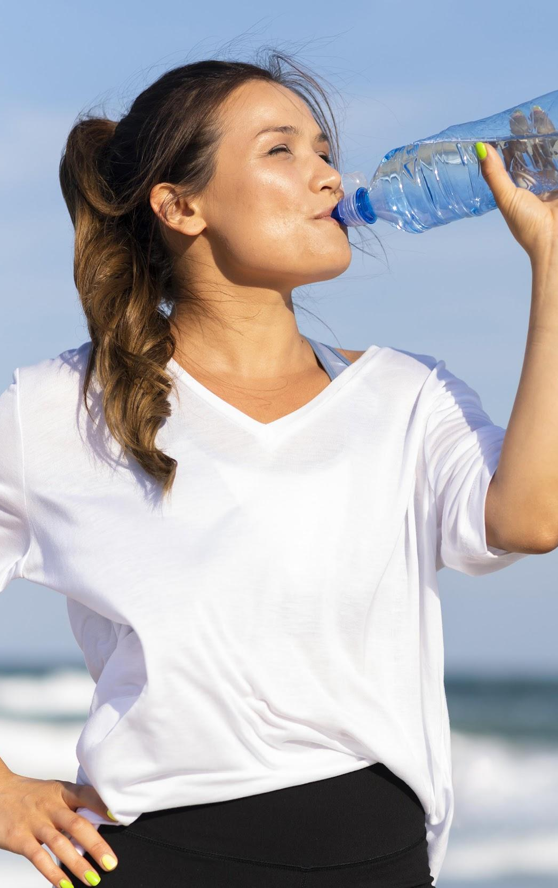
Introduction
Water is a basic human need. Although 71% of the earth is covered with water, only around 0.8% of the earth’s water is potable.
There are water and soft drinks beverages companies which takes water from water bodies for their production. But they need to confirm whether the water body can be used for human consumption.
QH2O water quality services is a company which tests the water quality of water bodies and manufactures purifying machines to purify the uncleaned water bodies.

Slide 4
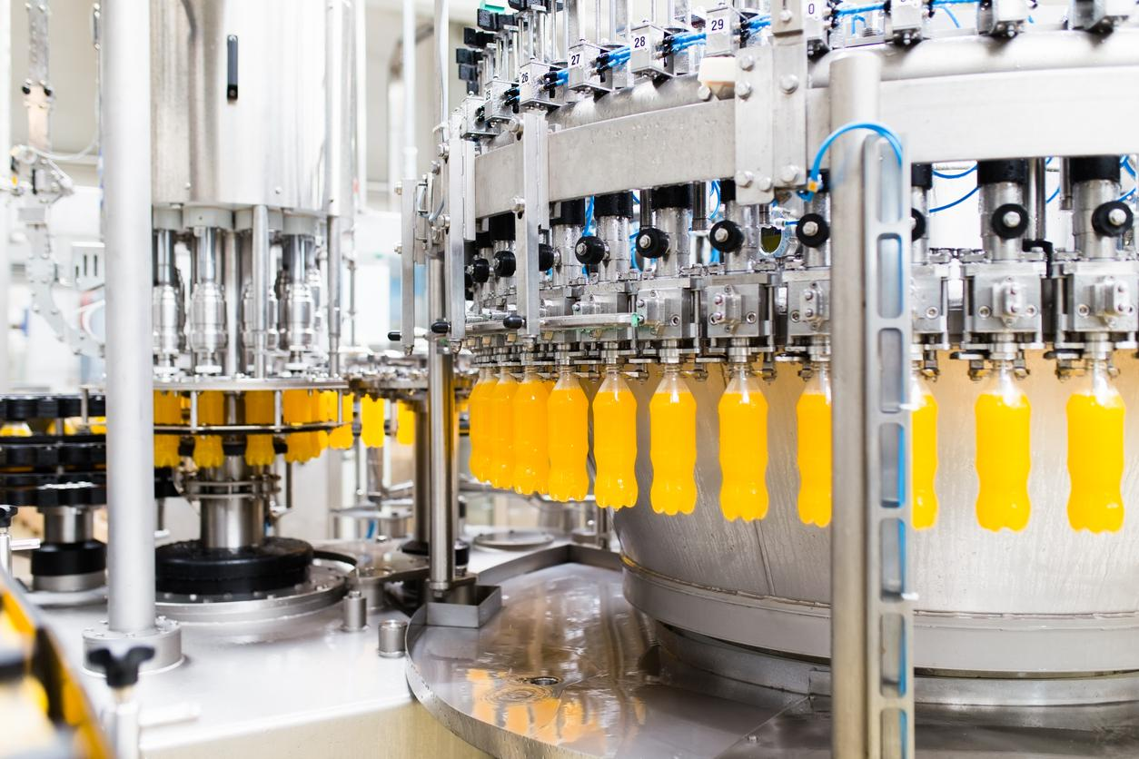
Description of the Problem
With all the polluted water resources in the world, identifying clean, potable water has become a necessity.
There are purifying services which test the water bodies manually to check whether the water stream is safe for consumption. But, this is a tedious task.
If a system is there to predict whether the water from different water streams is safe to consume or not, effectively, it will save the time of people.
It is also important to know which substances in the water that have a major impact on water pollution.
Finally a website is created for QH2O services, with the model to predict whether the water body is safe for human consumption.

Slide 5
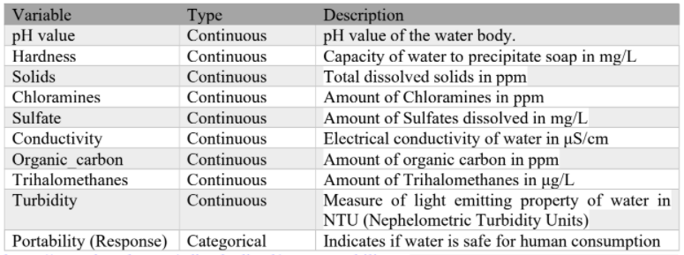
Dataset description
The dataset consists data of water quality metrics for 3276 different water bodies collected on 10 water quality metrics.

Slide 6
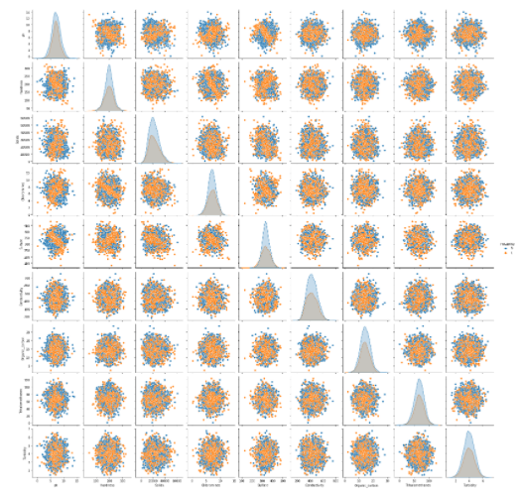
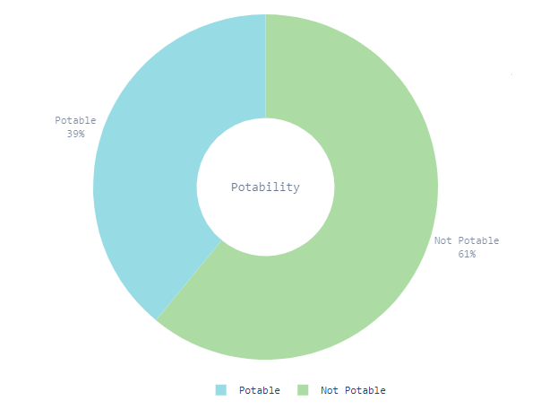
Summary of Descriptive Analysis

Slide 7
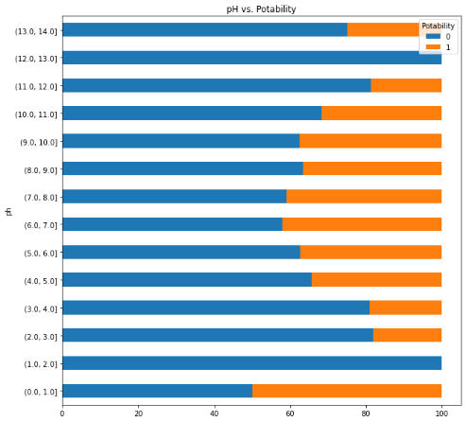
Analysis of pH
According to (World Health Organization, 2007), the pH of most drinking water lies within the range of 6.5–8.5.
The highest percentage of pH values of potable water falls within this range.
It is evident that the pH value is not the only factor for the water to be potable since the water of other pH levels is also potable in some percentages.

Slide 8
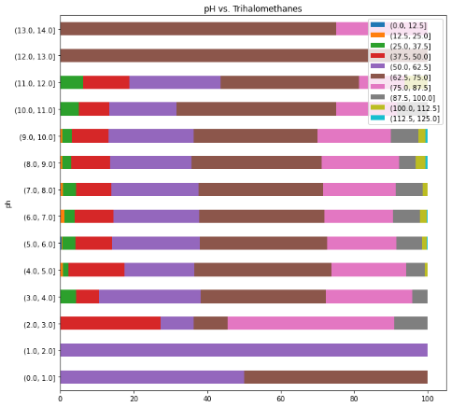
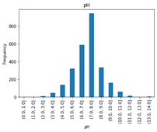
Analysis of pH
Even a small change of pH exerts a marked effect on trihalomethanes formation.
Therefore, even a minute pH fluctuations may result in wide variations of trihalomethanes (Amarasooriya et al, 2018).
In our dataset, even though the pH levels change, trihalomethane levels do not fluctuate massively.
This happens since a high amount of data has pH levels 6.00 – 8.00. The data from this category overshadows the fluctuations.

Slide 9
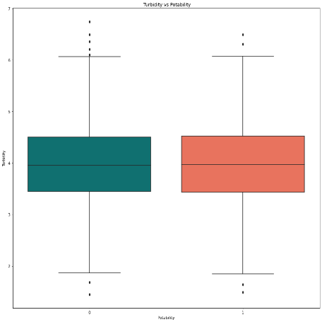
Analysis of Turbidity
Turbidity describes the cloudiness of water caused by suspended particles (WHO, 2017).
The WHO establishes that the turbidity of drinking water shouldn't be more than 5 NTU, and should ideally be below 1 NTU.
According to the figure, the turbidity of the majority of the data is below 5NTU.

Slide 10
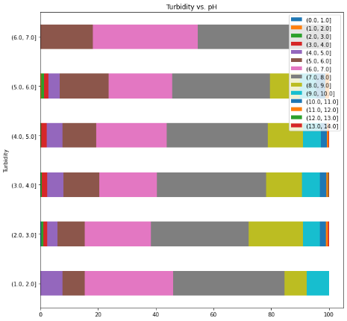
Analysis of Turbidity
The stacked bar chart of turbidity vs. pH values shows that when turbidity is increasing, the level of pH decreases.
According to (Mohammed, 2015), there is no significant direct influence of pH on turbidity.
When the turbidity is increasing, the conductivity also increases. Hence, there are free ions in the water at high turbidity levels.

Slide 11
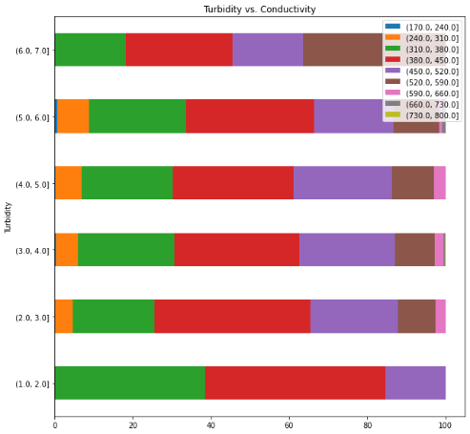
Analysis of Turbidity
According to (Hancock, n.d.), the coagulation process to eliminate turbidity requires positive ions.
There is a possibility of the coagulation process happening at high turbidity levels. It is stated in (Whitman.edu) that the coagulation process releases hydrogen ions into the water.
Hence, the pH values of water will be decreased. Therefore, when turbidity is increasing, the pH values will decrease.

Slide 12
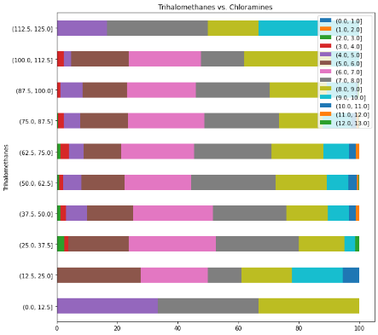
Analysis of Trihalomethanes
Trihalomethanes are the result of a reaction between the chlorine used for disinfecting tap water and natural organic matter in the water (Hood, 2005).
This can be seen from the figure as the level of trihalomethanes increases, the level of chloramines also increases.

Slide 13
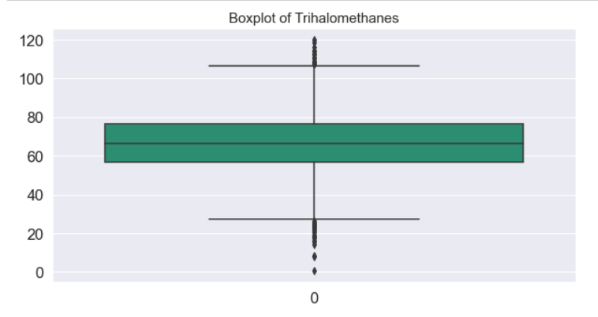
Analysis of Trihalomethanes
According to (EPA, 2016), the maximum allowable trihalomethanes level is 100 ppb.
Since the level of trihalomethanes of almost all the data is below 100ppb but not all the data is potable, we can declare that other factors affect the water potability than trihalomethanes.

Slide 14
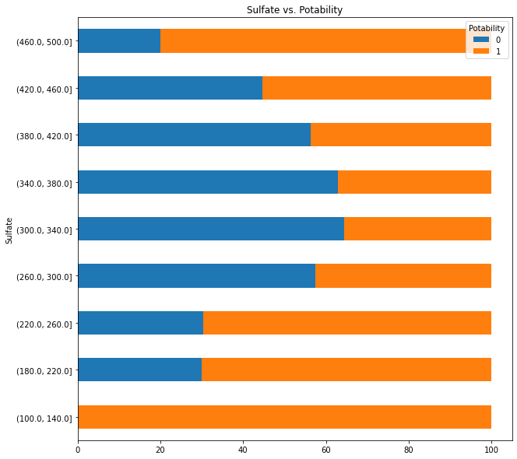
Analysis of Sulfate
According to (Oram, n.d.), The SMCL (Secondary Maximum Contaminant Level) for sulfate in drinking water is 250 mg/l.
It can be seen that there is a high percentage of potability around 250 mg/l sulfate levels in the dataset too.
There is a low water potability percentage in sulfate levels between 300 mg/l and 460mg/l.

Slide 15
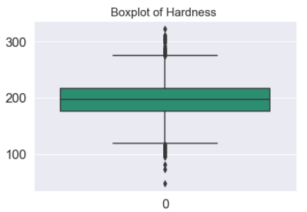
Analysis of Hardness
Water supplies with a hardness greater than 200 mg/L are considered poor but have been tolerated by consumers; those in excess of 500 mg/L are unacceptable for most domestic purposes (Health Canada, 1995).
According to the figure, the median hardness of the water is just below 200mg/l.

Slide 16
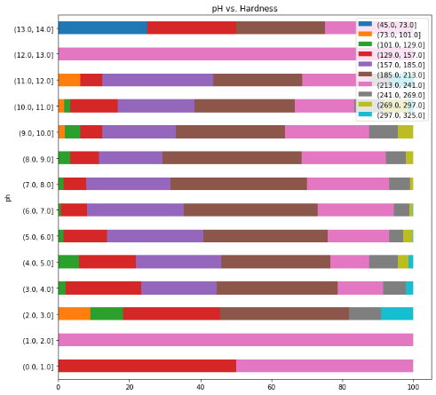
Analysis of Hardness
It is stated in (Think Fish, 2013) that dissolved minerals tend to counter the effects of acids in the water, preventing the pH from dropping.
Therefore, in most cases, hard water usually has a high (alkaline) pH, whilst soft water has a low (acidic) pH.
This does not reflect in the dataset.

Slide 17
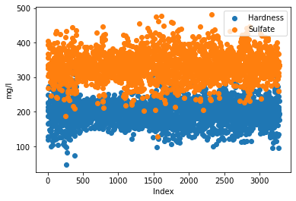
Analysis of Hardness
This can be due to the sulfate concentration being higher than the level of hardness in water since according to (Sulfate and water quality, n.d.), sulfates are most often related to their ability to form strong acids which change the pH.

Slide 18
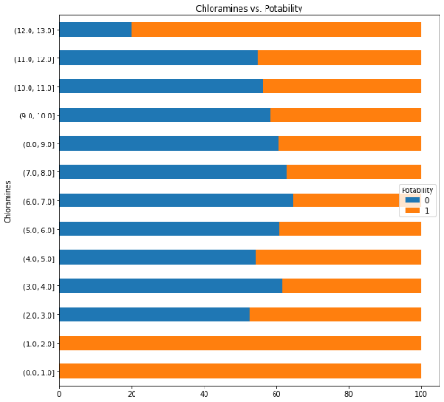
Analysis of Chloramines
Chloramine levels up to 4 mg/l or 4 ppm are considered safe in drinking water according to (CDC, 2020).
In the dataset, levels up to 3mg/l have a high percentage of potability.
But, in level 3mg/l to 4mg/l has a low percentage of potability.
This can be due to the high percentage of solids in those levels as according to (Oram, n.d.), elevated total dissolved solids can result in your water having a bitter or salty taste which affects the potability of water.
Notes:
Solid concentration

Slide 19
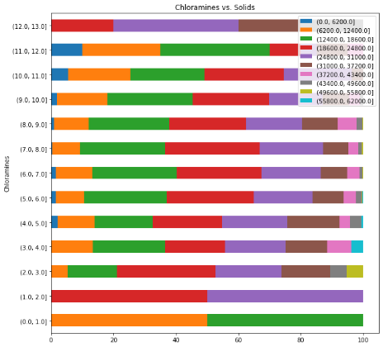
Analysis of Chloramines
(Friedler et al., 2021) stated that the regression coefficient of solids is negative when the level of solids is regressed against the level of chloramine.
This implies that the solids in water affect negatively in the process of chloramine disinfection.
This can be reflected in the figure since when the level of chloramine concentration is increasing, the level of solid concentration is decreasing.

Slide 20
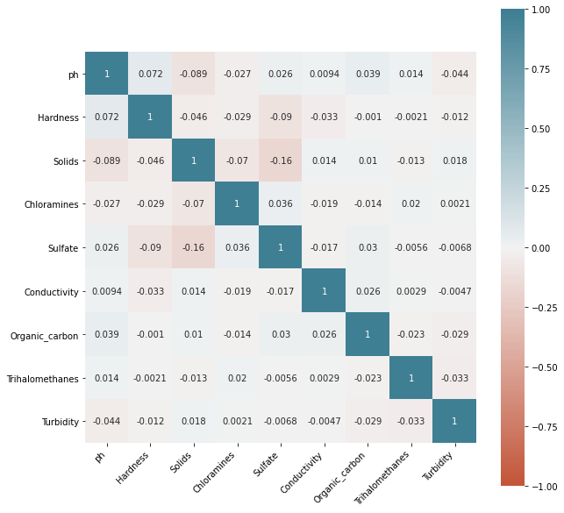
Correlation Plot

Slide 21
Results of Advanced Analysis

Slide 22
Logistic Regression
SELECTED FEATURES
ph
Hardness
Chloramines
Organic Carbon
Turbidity
BEST PARAMETERS
C | 1.0
SOLVER | LBFGS
Parameters were tuned using GRID search.
Features were selected using Recursive feature elimination.
Notes:
C - Inverse of regularization strength
Lbfgs used as optimization algorithm to find the local optimum
Recursive Feature Elimination was used to find the best features in logistic regression
['ph', 'Hardness', 'Chloramines', 'Organic_carbon', 'Turbidity']

Slide 23
Logistic Regression
 | Actual
Predicted |  | NO | YES
 | NO | 393 | 0
 | YES | 253 | 10
Accuracy Score | AUC Score
0.5991 | 0.5

Slide 24
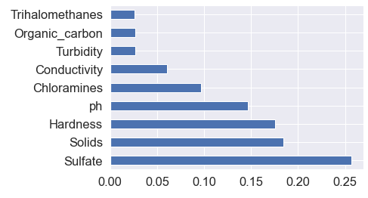
Decision Tree
BEST PARAMETERS
Max Depth | 9
Max features | auto
Min samples Leaf | 5
Min samples Split | 0.01
SELECTED FEATURES
Sulfate
Solids
Hardness
PH
Chloramines
Notes:
Max depth -The maximum depth of the tree
Min samples leaf - The minimum number of samples required to be at a leaf node.
Max features- The number of features to consider when looking for the best split: auto means sqrt
Min sample split- The minimum number of samples required to split an internal node:

Slide 25
Decision Tree
 | Actual
Predicted |  | NO | YES
 | NO | 354 | 39
 | YES | 199 | 64
Accuracy Score | AUC Score
0.6372 | 0.5720

Slide 26
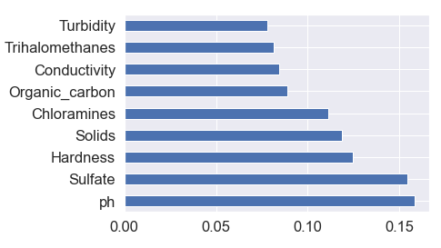
Random Forest
BEST PARAMETERS
Max Depth | 10
Max features | auto
n_estimators | 400
criterion | entropy
SELECTED FEATURES
PH
Sulfate
Hardness
Solids
Chloramines
Notes:
Max depth -The maximum depth of the tree
N estimators - number of trees
Max features- The number of features to consider when looking for the best split: auto means sqrt

Slide 27
Random Forest
 | Actual
Predicted |  | NO | YES
 | NO | 368 | 25
 | YES | 190 | 73
Accuracy Score | AUC Score
0.6723 | 0.6069

Slide 28
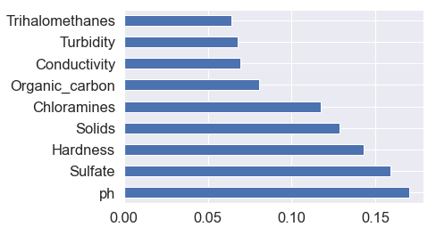
XGBOOST
BEST PARAMETERS
Max Depth | 10
gamma | 0.1
Learning rate | 0.01
n_estimators | 300
Sub sample | 0.6
SELECTED FEATURES
PH
Sulfate
Hardness
Solids
Chloramines
Notes:
Max depth -The maximum depth of the tree
Learning rate- step size shrinkage used in update to prevent overfitting
N estimators - number of trees
Gamma - a node os split only when the resulting split gives positive reduction in loss function(minim loss reduction)
Max features- The number of features to consider when looking for the best split: auto means sqrt

Slide 29
XGBoost
 | Actual
Predicted |  | NO | YES
 | NO | 356 | 37
 | YES | 166 | 97
Accuracy Score | AUC Score
0.6992 | 0.6373

Slide 30
Summary of the advanced analysis
Classifiers | AUC | Accuracy
Logistic regression | 0.5 | 59.91%
Decision Tree | 0.5720 | 63.72%
Random forest | 0.6069 | 67.23%
XGBoost | 0.6473 | 69.92%

Slide 31
Issues Encountered and Proposed Solution
There were missing values for PH, Sulfate and Trihalomethanes. Missing values were imputed using the mean since the variables are normally distributed.
There were outliers in the variables. Those outliers were replaced with max and min values using capping method since the size of the dataset is small.
The models can be improved by getting more observations.
Notes:
Capping is setting a limit for the feature and set the value of all the outliers exceeding the limit to the value of the limit.

Slide 32
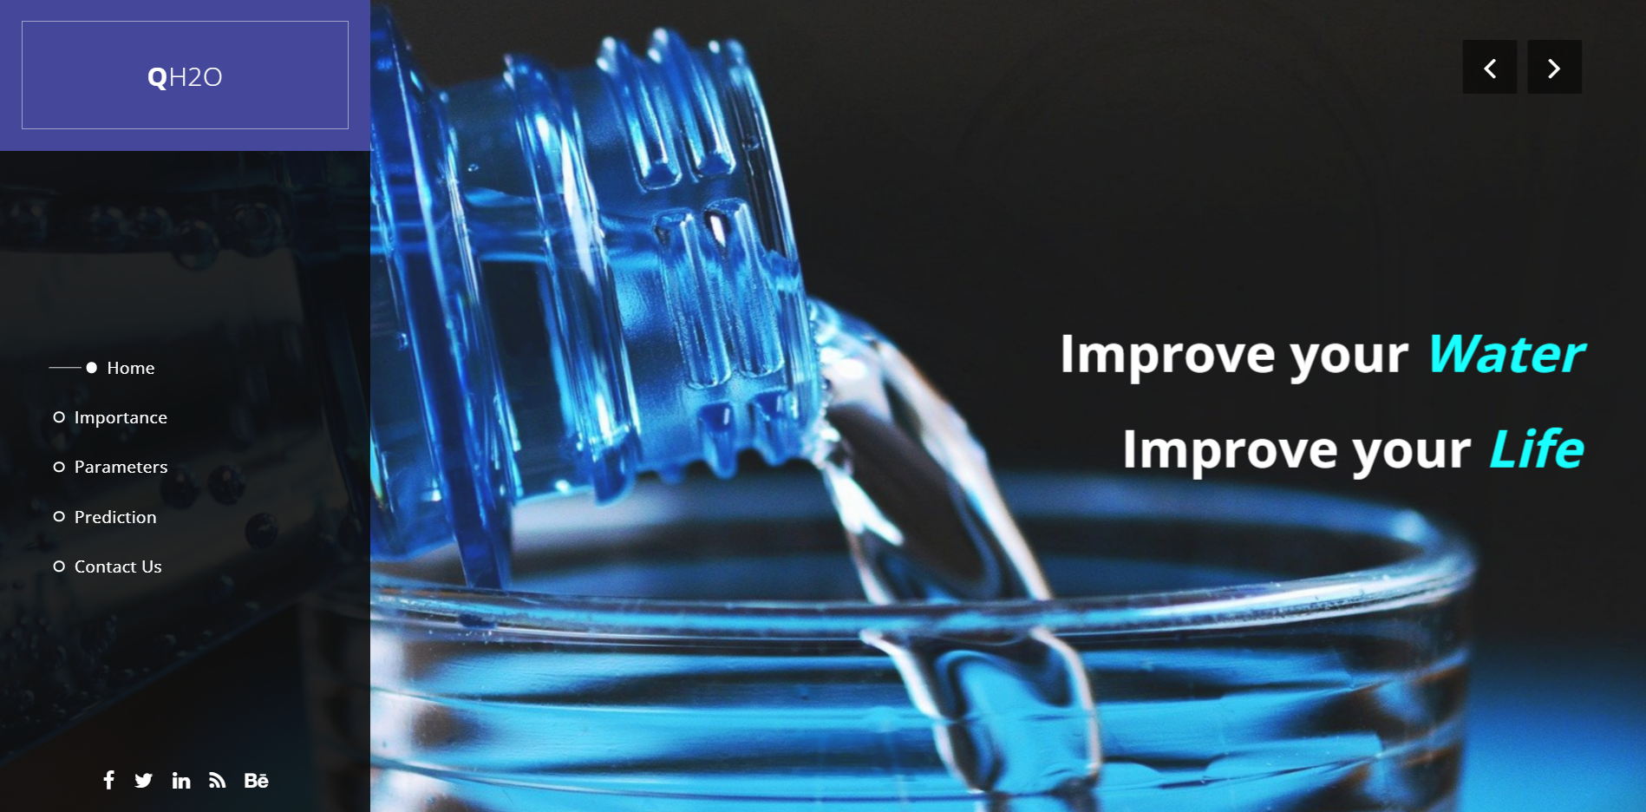
QH2O Water Quality Services
This website is used as the data product which predicts whether water sample is portable or not.

Slide 33
References
Health Canada. (1995). Sources and Levels of Hardness. World Health, 1979(February 1979), 40–43.
Friedler, E., Chavez, D. F., Alfiya, Y., Gilboa, Y., & Gross, A. (2021). Impact of suspended solids and organic matter on chlorine and UV disinfection efficiency of greywater. Water (Switzerland), 13(2). https://doi.org/10.3390/w13020214
Hood, E., 2005. Tap Water and Trihalomethanes: Flow of Concerns Continues. Environmental Health Perspectives, 113(7).
Amarasooriya, A., Weragoda, S., Makehelwala, M. and Weerasooriya, R., 2018. Occurrence of trihalomethane in relation to treatment technologies and water quality under tropical conditions. H2Open Journal, 1(1), pp.69-83.
Mohammed, S., 2015. Effect of pH on the Turbidity Removal of Wastewater. OALib, 02(12), pp.1-9.
World Health Organisation. (2007). pH in drinking-water. Guidelines for Drinking Water Quality, 2(2), 1–7. http://www.who.int/water_sanitation_health/dwq/chemicals/ph_revised_2007_clean_version.pdf
Usgs.gov. 2021. Hardness of Water. [online] Available at: <https://www.usgs.gov/special-topic/water-science-school/science/hardness-water?qt-science_center_objects=0#qt-science_center_objects>.

Slide 34
THANKS

